Slide 1
Memory Allocations for Tiled Uniform Dependence Programs
Tomofumi Yuki and Sanjay Rajopadhye

Slide 2
Parametric Tiling
Series of advances
Perfect loop nests [Renganarayanan2007]
Imperfectly nested loops [Hartono2009, Kim2009]
Parallelization [Hartono2010, Kim2010]
Key idea:
Step out of the polyhedral model
Parametric tiling is not affine
Use syntactic manipulations

Slide 3
Memory Allocations
Series of polyhedral approaches
Affine Projections [Wilde & Rajopadhye 1996]
Pseudo-Projections [Lefebvre & Feautrier 1998]
Dimension-wise “optimal” [Quilleré & Rajopadhye 2000]
Lattice-based [Darte et al. 2005]
Cannot be used for parametric tiles
Can be used to allocate per tile [Guelton et al. 2011]
Difficult to combine parametric tiling with memory-reallocation

Slide 4
This paper
Find allocations valid for a set of schedules
Tiled execution by any tile size
Based on Occupancy Vectors [Strout et al. 1998]
Restrict the universe to tiled execution
Quasi-Universal Occupancy Vectors
More compact allocations than UOV
Analytically find the shortest Quasi-UOV
UOV-guided index-set splitting
Separate boundaries to reduce memory usage

Slide 5
Outline
Introduction
Universal Occupancy Vectors (review)
Lengths of UOVs
Overview of the proposed flow
Finding the shortest QUOV
UOV-guided Index-set Splitting
Related Work
Conclusions

Slide 6
Universal Occupancy Vectors
Find a valid allocation for any legal schedules
Occupancy vector: ov
Value produced at z is dead by z+ov
Assumptions
Same dependence pattern
Single statement
Legal schedule can even be from run-time scheduler
Find an iteration that depends on all the uses.
Live until these 4 iterations are executed.

Slide 7
Lengths of UOVs
Shorter ≠ Better
The shape of iteration space has influence
A good “rule of thumb” when shape is not known
Increase in Manhattan distance usually leads increase in memory usage

Slide 8
Proposed Flow
Input: Polyhedral representation of a program
no memory-based dependences
Make scheduling choices
The result should be (partially) tilable
Apply schedules as affine transforms
Lex. scan of the space now reflects schedule
Apply UOV-based index-set splitting
Apply QUOV-based allocation

Slide 9
UOV for Tilable Space
We know that the iteration space will be tiled
Dependences are always in the first orthant
Certain order is always imposed
➔ Implicit dependences

Slide 10
Finding the shortest QUOV
1. Create a bounding hyper-rectangle
Smallest that contains all dependences
2. The diagonal is the shortest UOV
Intuition
No dependence goes “backwards”
Property of tilable space

Slide 11
Outline
Introduction
Universal Occupancy Vectors (review)
Lengths of UOVs
Overview of the proposed flow
Finding the shortest QUOV
UOV-guided Index-set Splitting
Related Work
Conclusions

Slide 12
Dependences at Boundaries
Many boundary conditions in polyhedral representation of programs
e.g., Gauss Seidel 2D (from polybench)
Single C statement, 10+ boundary cases
May negatively influence storage mapping
With per-statement projective allocations
Different life-times at boundaries
May be longer than the main body
Allocating separately may also be inefficient

Slide 13
UOV-Based Index-Set Splitting
“Smart” choice of boundaries to separate out
Those that influence the shortest QUOV
Example:
Dashed dependences = boundary dependences
Removing one has no effect
Removing the other shrinks the bounding hyper-rect.

Slide 14
Related Work
Affine Occupancy Vectors [Thies et al. 2001]
Restrict the universe to affine schedules
Comparison with schedule-dependent methods
Schedule-dependent methods are at least as good as UOV or QUOV based approaches
UOV based methods may not be as inefficient as one might think
Provided O(d-1) data is required for d dimensional space
UOV-based methods are single projection

Slide 15
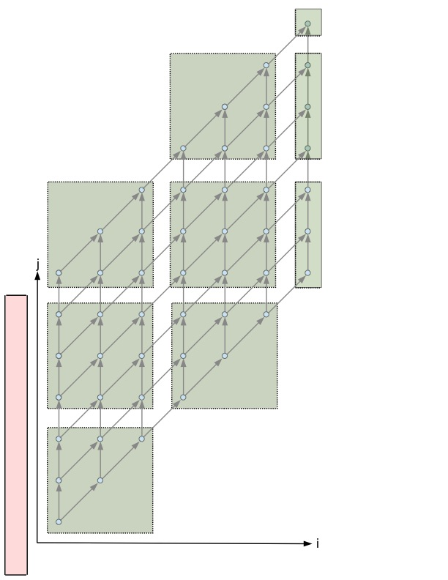
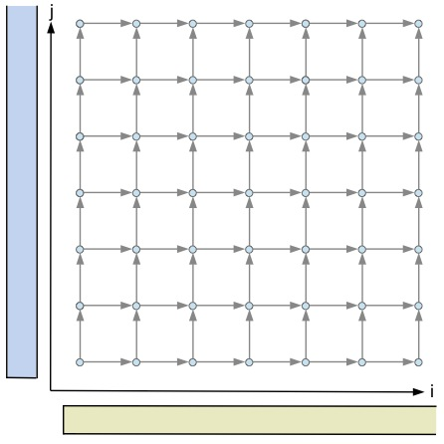
Example
Smith-Waterman (-like) dependences

Slide 16
Summary and Conclusion
We “expand” the concept of UOV to a smaller universe: tiled execution
We use properties in such universe to find:
More compact allocations
Shortest QUOVs
Profitable index-set splitting
Possible approach for parametrically tiled programs

Slide 17
Acknowledgements
Michelle Strout
For discussion and feedback
IMPACT PC and Chairs
Our paper is in a much better shape after revisions

Slide 18
Extensions to Multi-Statement
Schedule-Independent mapping is for programs with single statement
We reduce the universality to tiled execution
Multi-statement programs can be handled
Intuition:
When tiling a loop nest, the same affine transform (schedule) is applied to all statements
Dependences remain the same

Slide 19
Dependence Subsumption
Some dependences may be excluded when considering UOVs and QUOVs
A dependence f subsumes a set of dependences I if f can be expressed transitively by dependences in I
Valid UOV for the left is also valid for the right.

